Slide 1
Basic Linux Commands

Slide 2
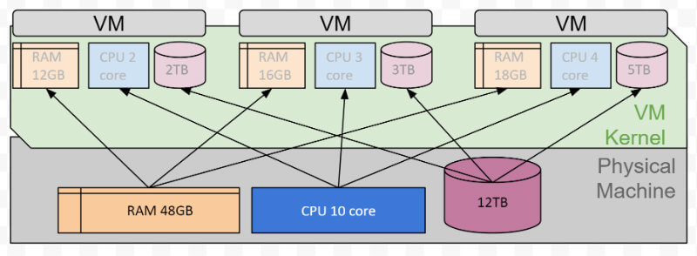
Operating System and VM

Slide 3
Linux file structure

Slide 4
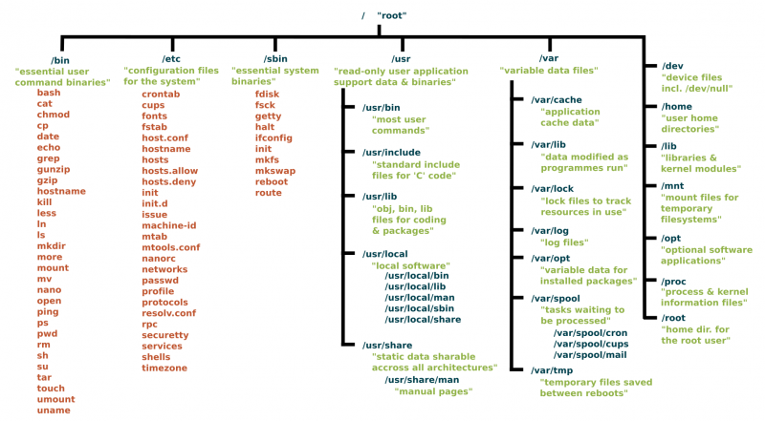
https://www.linux.com/sites/lcom/files/styles/rendered_file/public/standard-unix-filesystem-hierarchy.png?itok=CVqmyk6P

Slide 5
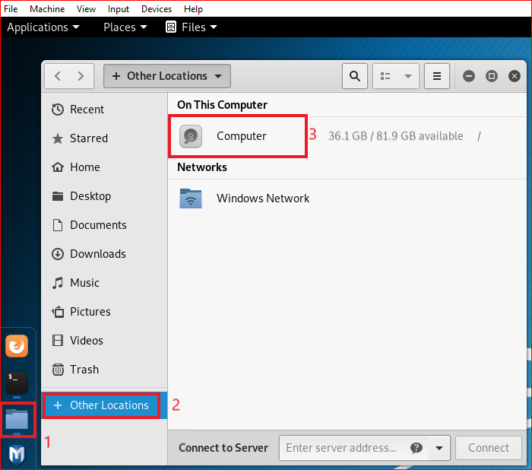

Slide 6
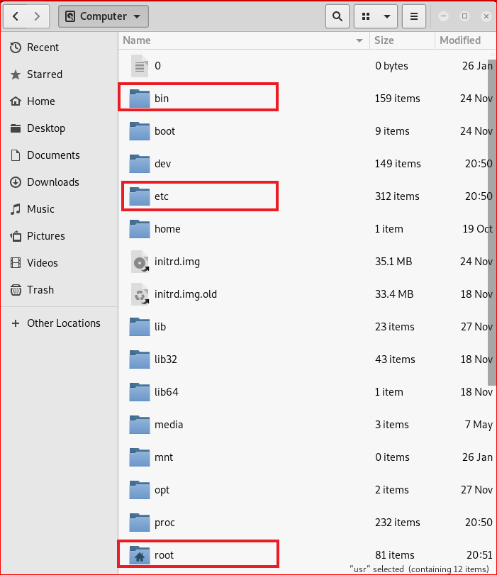

Slide 7
Folders

Slide 8
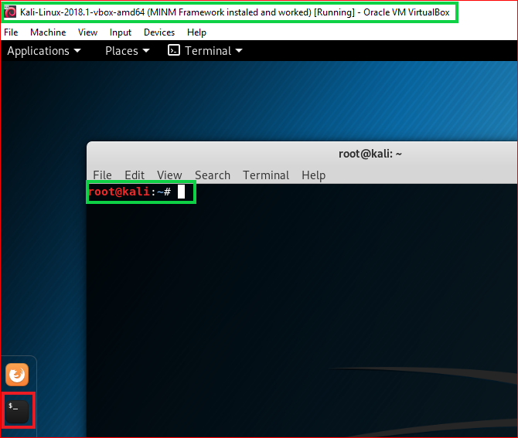

Slide 9
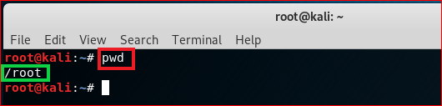
print working directory (pwd)

Slide 10

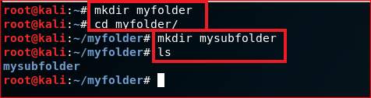
create folders
Root directory
root
\myfolder
\mysubfolder

Slide 11
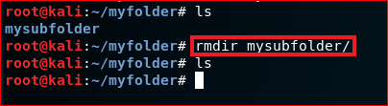
Delete folders

Slide 12
File operations

Slide 13
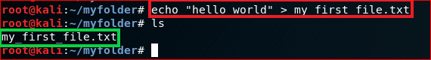
Create a new text file
root
\myfolder
hello world
my_first_file.txt

Slide 14
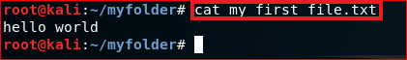
Show the content of the file: cat

Slide 15
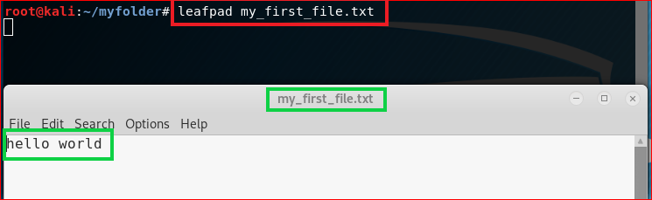
Show the content of the file

Slide 16
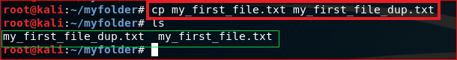
Copy (cp) a file

Slide 17
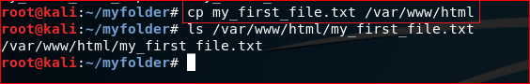
Copy (cp) a file to a different location

Slide 18
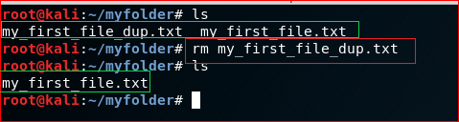
Remove a file: rm

Slide 19
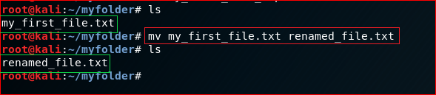
Rename a file (mv)

Slide 20
Networking

Slide 21
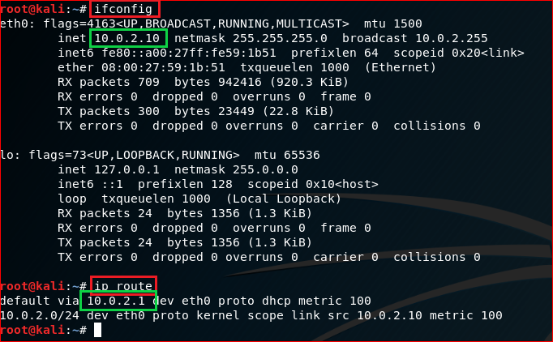
IP default gateway

Slide 22
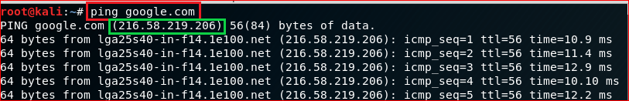
Test network connection using domain name

Slide 23
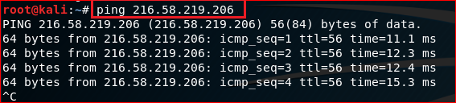
Test network connection using IP

Slide 24
Download files

Slide 25
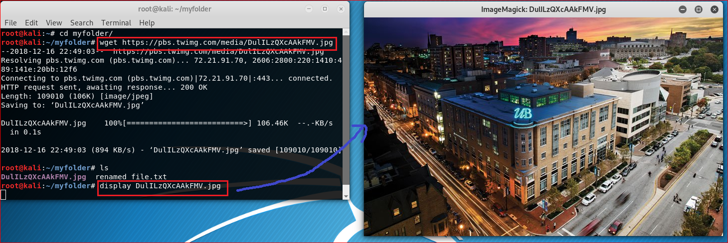
https://pbs.twimg.com/media/DulILzQXcAAkFMV.jpg

Slide 26
Update/Install software

Slide 27
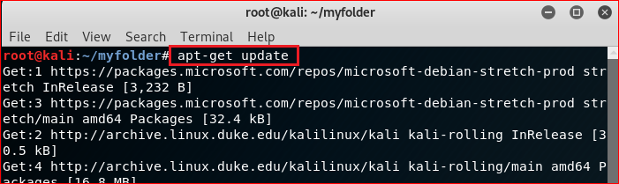
Update software

Slide 28
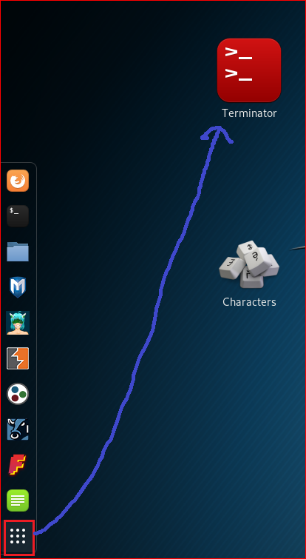
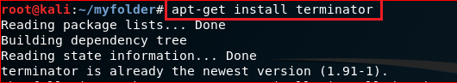
Install terminator

Slide 29
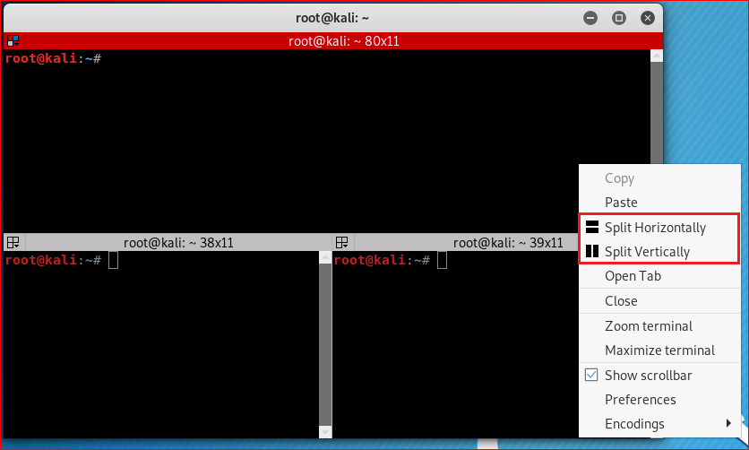

Slide 30
Compress files

Slide 31
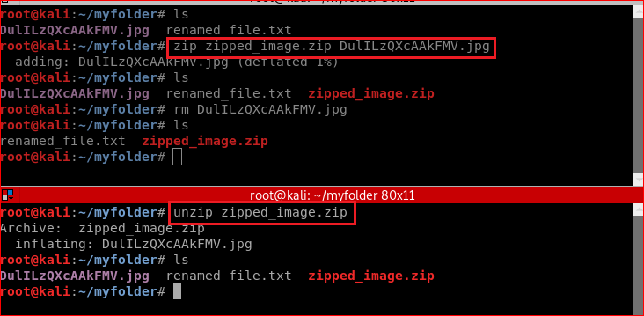
Zip/unzip files

Slide 32
Reference
https://www.linux.com/blog/learn/intro-to-linux/2018/4/linux-filesystem-explained

